Slide 1
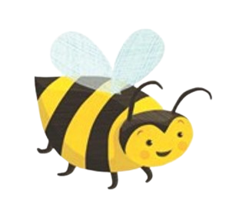
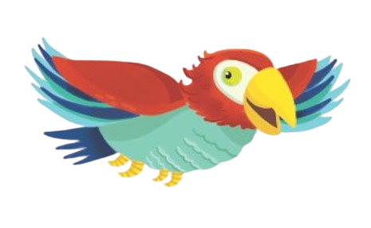
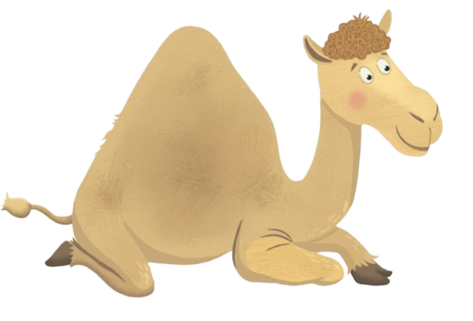
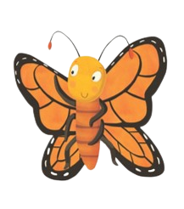
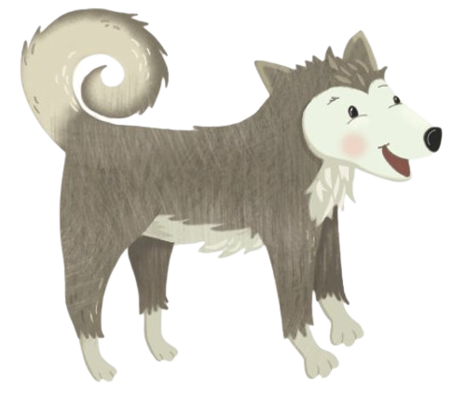
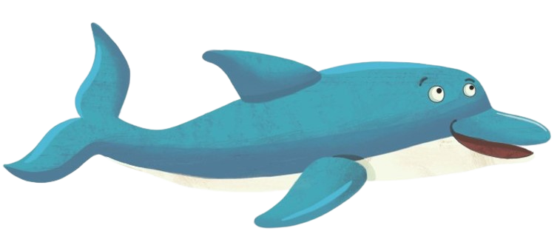
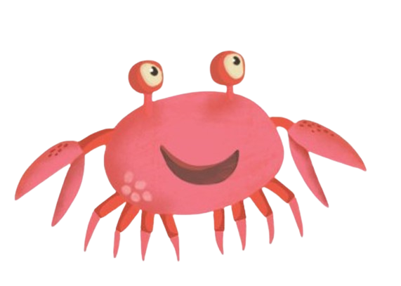
Join Pebbles and her friends to learn all about BUTTERFLIES

Slide 2
This week we will learn:
the parts of a butterfly
the life cycle of a butterfly
monarch butterfly patterns
monarch butterfly migration
what butterflies need to live
How will we learn this:
read a book
watch some videos
complete a science workbook
draw pictures
answer questions

Slide 3
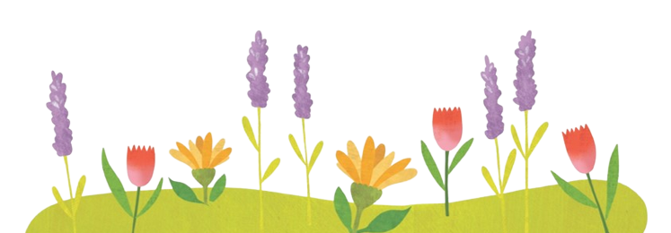
Bzz bzzz . . Let’s brainstorm!
What do we already know about butterflies?
What do we want to learn about butterflies?
Write your questions on page 1 of your
science workbook.

Slide 4
Now let’s read the book

Slide 5
Now that we’ve read the book “Pebbles and the Biggest Number”, let’s think about what we’ve learned.
What is one thing you learned from reading the book that you didn’t know before?
Draw a picture that shows what you learned on page 2 of your science workbook.

Slide 6
Let’s watch a video to learn more about
monarch butterflies!
During the movie see if you can find the answers to these questions.
What are the parts of a butterfly’s body?
What does each part do?
Where do monarch butterflies travel to
and from?

Slide 8
Let’s talk about the parts of a butterfly!
Open your science workbook to pages 3 and 4. Get out your crayons to complete the activity.

Slide 9
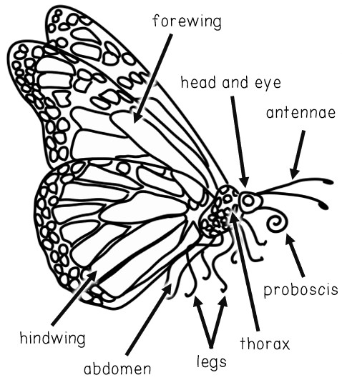
What part of the butterfly’s body helps them fly?
Do we have a body part that helps us fly?
Color the body part that helps butterflies fly BLUE.

Slide 10
What part of the butterfly’s body helps them see?
What body part helps humans see?
Color the body part that helps butterflies see GREEN.

Slide 11
What part of the butterfly’s body helps them eat?
What body part helps humans eat?
Circle the body part that helps butterflies eat with RED.

Slide 12
What part of the butterfly’s body helps them smell and balance?
Do we have a body part that helps us smell or balance?
Circle the body part that helps butterflies smell and balance with ORANGE.

Slide 13
What part of the butterfly’s body helps them to walk?
What body part helps humans to walk?
Circle the body part that helps butterflies walk with PURPLE.

Slide 14
What are the three main sections of a butterfly’s body?
What sections of human bodies are similar to butterfly bodies?
Color the butterfly’s head, thorax, and abdomen YELLOW.

Slide 15
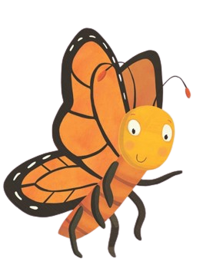
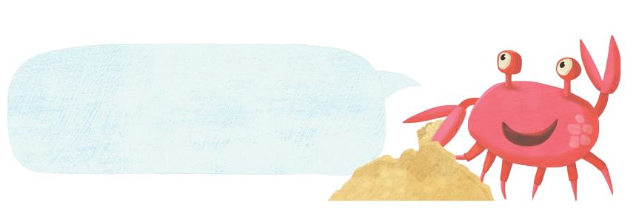
Hi Pebbles! Pebbles is a monarch butterfly. Let’s talk about monarch butterfly migration!
Open your science workbook to
pages 5 and 6.

Slide 16
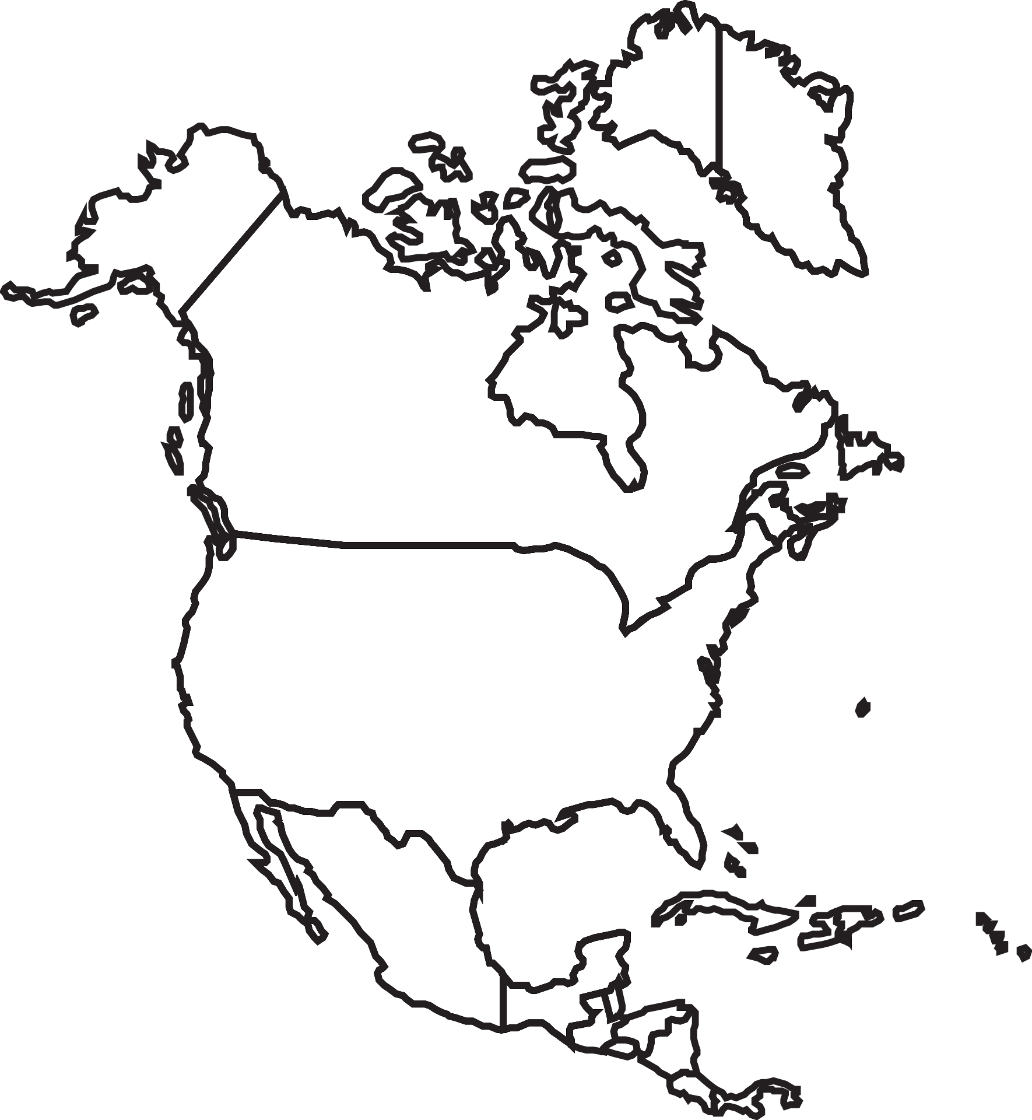
This is a map of North America.
Can you identify Canada, The United States and Mexico?

Slide 17
Monarch butterflies migrate from southern Canada all the way to Mexico
Draw an arrow from Canada to Mexico
Canada
United States
Mexico

Slide 18
Monarch butterflies also migrate from the northern United States to Mexico too
Draw an arrow from the United States to Mexico
Canada
United States
Mexico

Slide 19
Monarch butterflies migrate from Mexico back to Canada and the United States
Draw arrows from Mexico back to the United States and Canada.
Canada
United States
Mexico

Slide 20
Is your home shown on this map?
If your home is on the map, draw a star to show where you live.
Canada
United States
Mexico

Slide 21
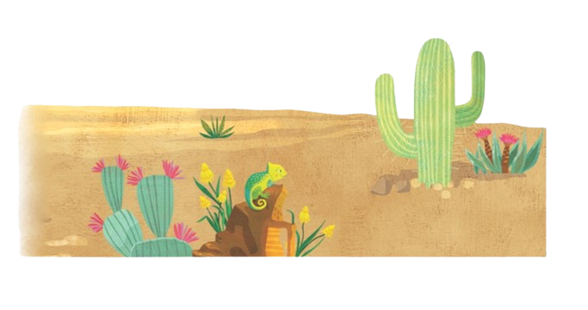
Let’s watch this video to remind ourselves about the life cycle of the monarch butterfly.
While you watch, see if you can find the answers to these questions.
How many stages are in the butterfly
life cycle?
Can you name the stages in order?

Slide 23
Let’s look at the Life Cycle of a Butterfly more closely!
Open your science workbook to pages 7 and 8. Grab a pair of scissors and a glue stick to complete this activity.

Slide 24
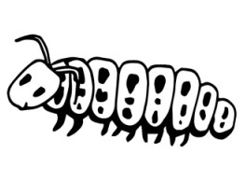
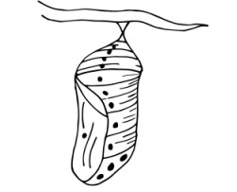
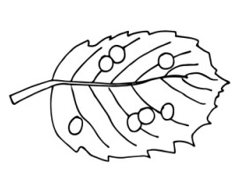
Look at each of the pictures on page 7.
Can you identify which picture shows each part of the butterfly life cycle?
Which picture shows an egg, larva, pupa, and adult?

Slide 25
Cut out each picture on page 7.
Glue each picture under the matching stage of the butterfly life cycle on page 8.

Slide 26
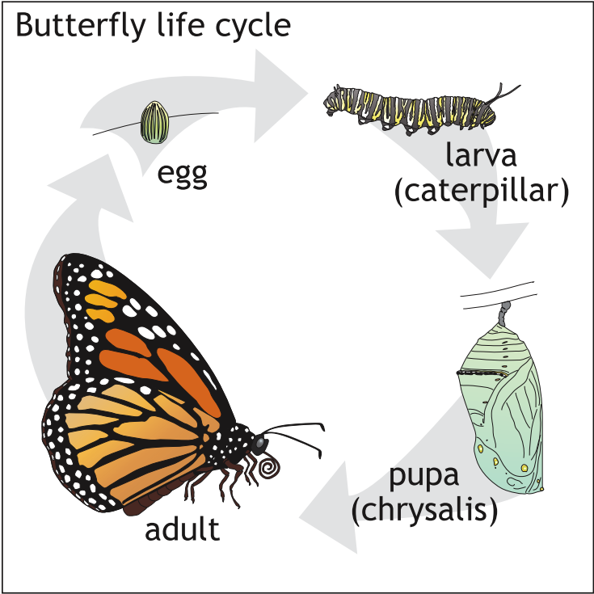
Look at the Butterfly
Life Cycle.
Can you see how
the stages of a
butterfly’s life form a circle?
Did you notice that two of the stages can have different names?

Slide 27
Let’s take a closer look at each stage of the Butterfly Life Cycle.
Observe pictures of the monarch butterfly in each stage of development.
Draw a picture to represent each stage on pages 9, 10, 11 and 12. Get out a pencil and crayons to complete this activity.

Slide 28
Stage 1 - EGG
Draw a picture of a monarch butterfly egg on page 9.

Slide 29
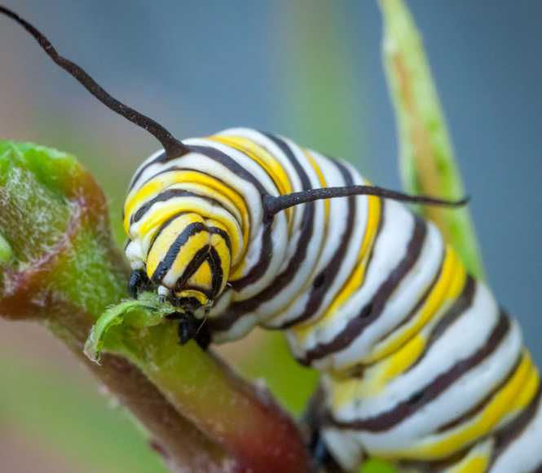
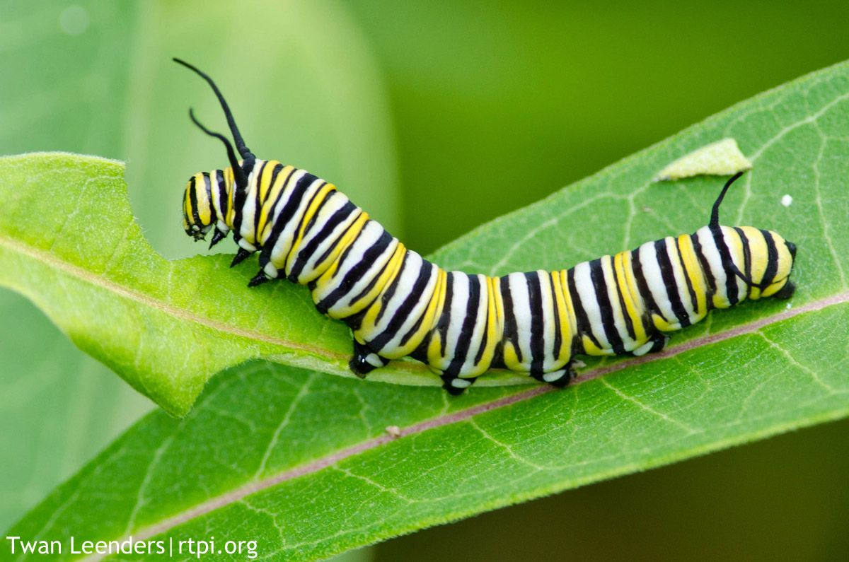
Stage 2 - LARVA
Draw a picture of a monarch caterpillar or larva on page 10.

Slide 30
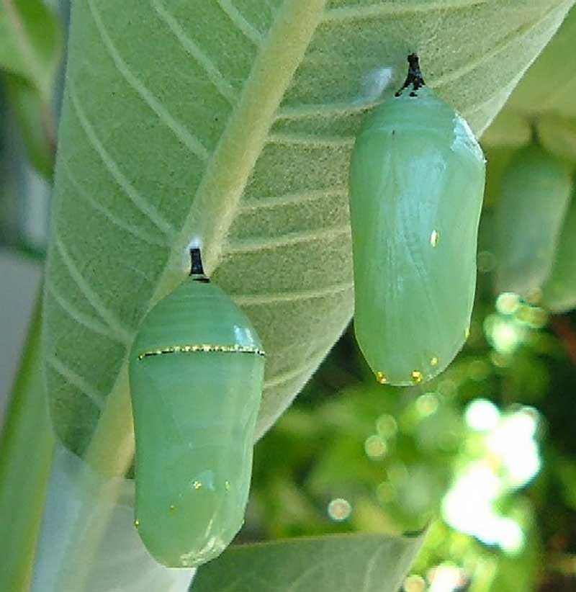
Stage 3 - PUPA
Draw a picture of a monarch pupa or chrysalis on page 11.

Slide 31
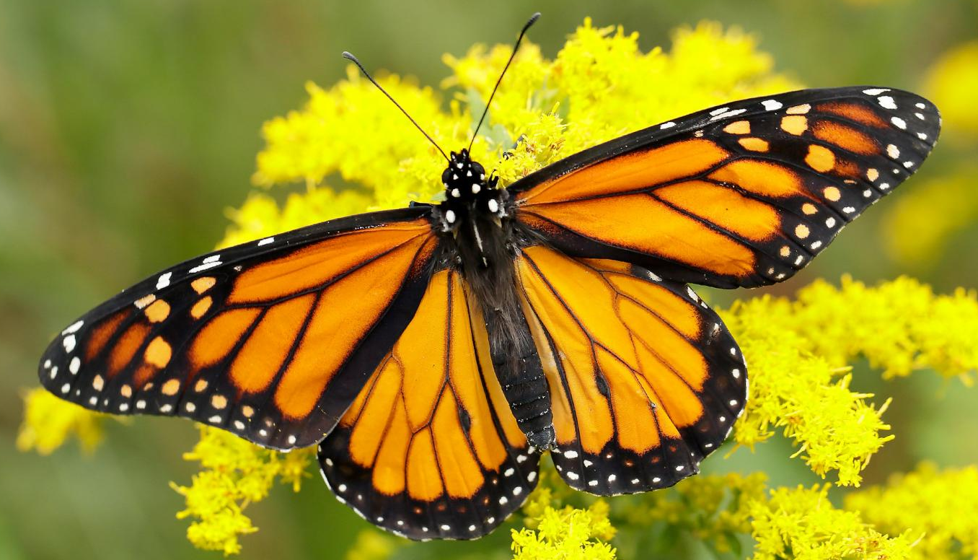
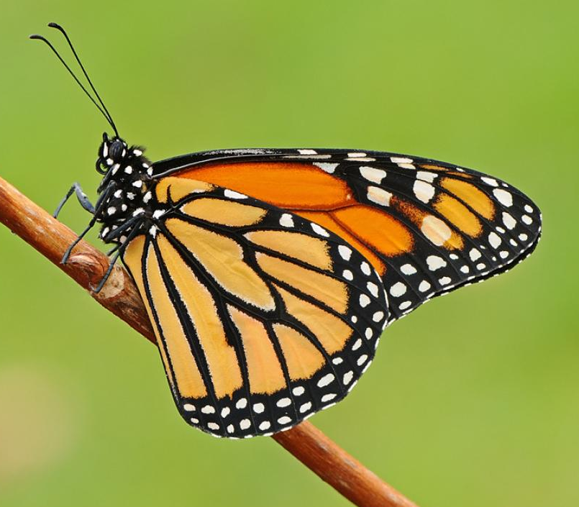
Stage 4 - ADULT
Draw a picture of an adult monarch butterfly on page 12.

Slide 32
Let’s talk about butterfly needs!
Open your science workbook to page 13. Grab a pencil to complete this activity.

Slide 33
Let’s look back at what we already know about Pebbles and her monarch butterfly friends.
Look back at page 2 to see what you learned from reading the book Pebbles and the Biggest Number.
Check out pages 3 and 4 to remember how a butterfly eats, walks, sees, and flies.

Slide 34
Let’s keep looking at all the information we’ve learned about monarch butterflies.
Look back at page 8 to see the butterfly life cycle.
Check out your drawings on pages 9, 10, 11, and 12 to remember how a monarch transforms from egg to larva to pupa and finally to adulthood.

Slide 35
See if you can answer some of these questions about butterflies.
What habitat would a monarch butterfly live in?
What temperatures and weather would a butterfly like for living and flying?
What food does a butterfly need to be healthy?
Where does a monarch butterfly lay her eggs so her future caterpillar babies can eat?

Slide 36
Turn to pages 13 and 14 in your science workbook.
List three things a monarch butterfly would need to be healthy on page 13.
Draw a picture showing the three things you listed on page 14.

Slide 37
We’ve learned soooo much information about monarch butterflies like Pebbles!
I wonder if we can tell the difference between monarch butterflies and other kinds of butterflies.
Do you know what colors and patterns a monarch butterfly like Pebbles has on their wings?

Slide 38
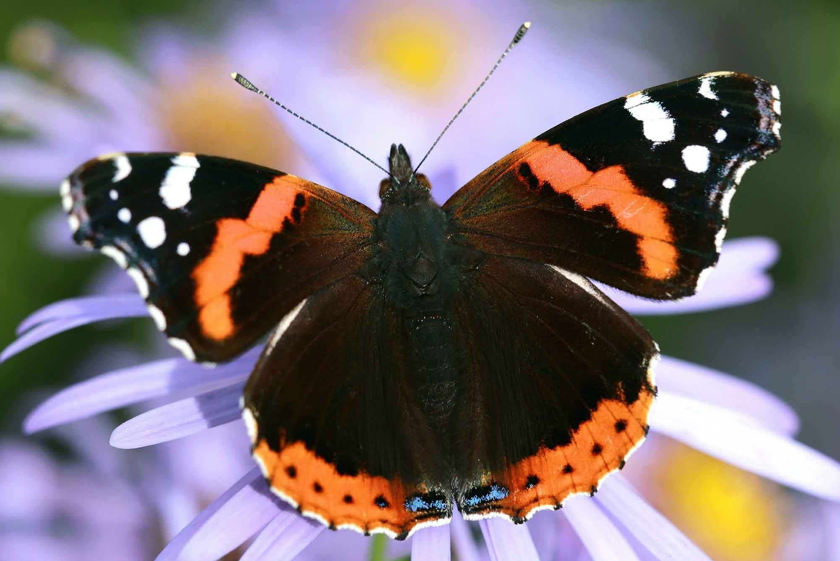
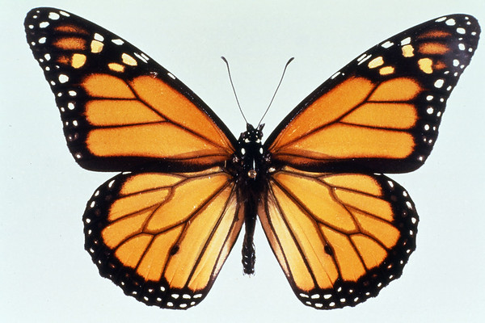
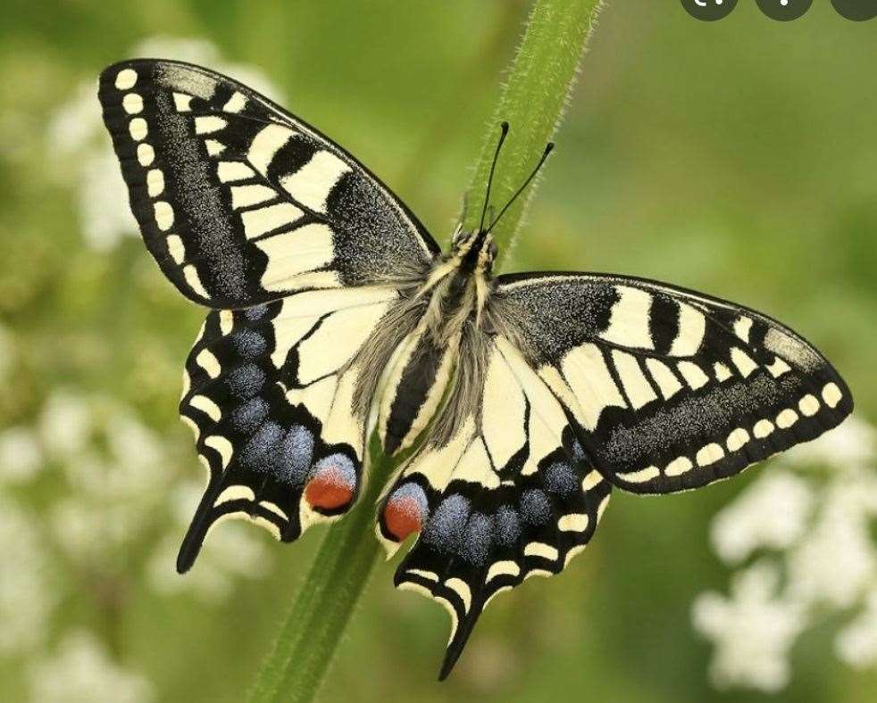
Can you spot the monarch butterfly, like my friend Pebbles?

Slide 39
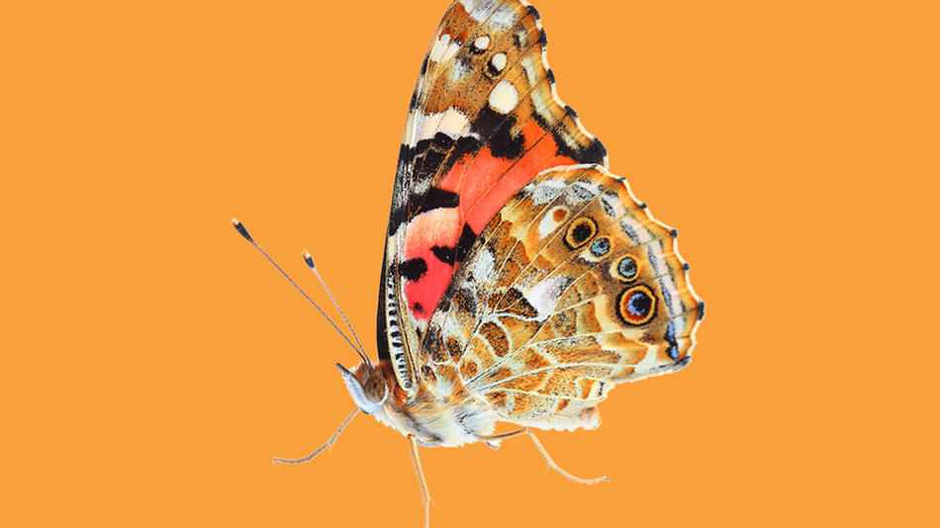
How about now, can
you still spot the monarch butterfly?

Slide 40
Turn to pages 15 and 16 in your science workbook.
Now that you know what colors and patterns a monarch butterfly has, color Pebbles on page 15.
Get creative on page 16 and draw the butterfly of your choice! It can be a real butterfly we’ve seen or from your imagination. Give your butterfly the colors and patterns you want!

Slide 41
Thanks for learning about butterflies with Pebbles and her friends!

